Slide 1
Health Systems Advocacy Partnership Role of the Partnershipdesk & Dutch MoFA

Slide 2
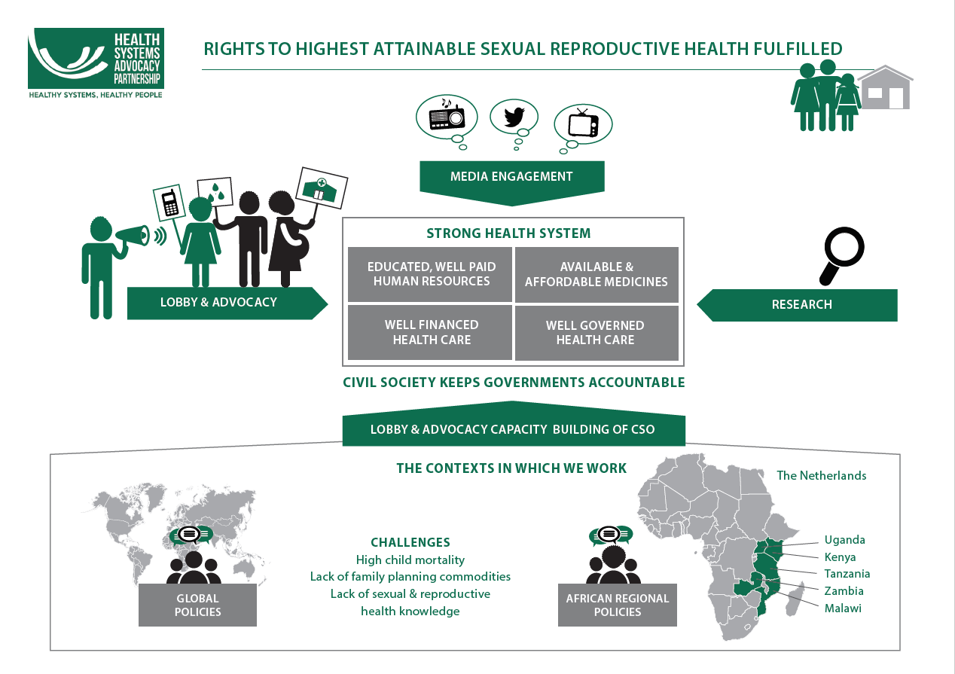

Slide 3
Background funding framework HSAP
The Health systems Advocacy Partnership is one of the 25 Dialogue and Dissent Partnerships funded by the Dutch Ministry of Foreign Affairs.
Rationale: CSOs are the voice of citizens at local, national and international level. They can help make government more accountable to citizens and increase its legitimacy.
Key program strategies: Research, Lobby & Advocacy, Capacity building for Lobby & Advocacy.
Time frame: 2016 - 2020
Key evaluation criteria: Strenghten the Lobby & Advocacy capacity of Sourthern CSO’s
Notes:
The ministry is not just a donor but also a ‘partner’.
In doing so, they contribute to greater social cohesion, stronger and more open democracies, a better response to environmental problems, a better business climate, more opportunities for all and less inequality.
Dutch government provides funds for dissent.

Slide 4
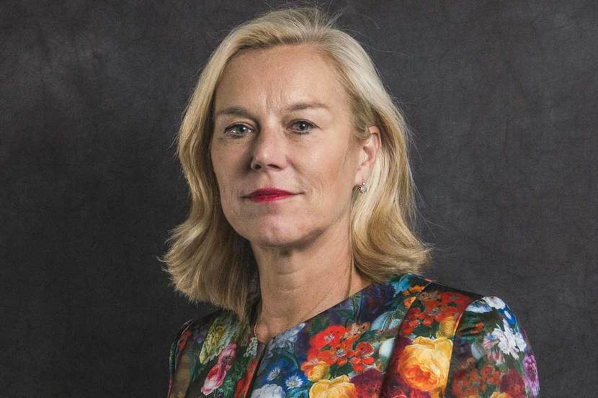
Policy priorities Netherlands MoFA
History:
SRHR is traditionally one of the four core themes of Dutch development policy.
Current developments:
May 2018, new minister present policy note ‘investing in global prospects’
Main changes relevant to HSAP:
SRHR has remained priority but focus seems to shift to gender
Migration is a hot topic -> shift to unstable countries closer to Europe
Intention to continue with D&D framework
Notes:
Bilateral aid focussed on 15 countries including Uganda and TZ
global health is not a focus despite interest from ministry of health.
More southern ownership. Dutch organisations focus more on innovation, communication and international level L&A.

Slide 5
How can we influence the Dutch policy?
From september 2018 Dutch development policy will be operationalized, NL Lobby team sees most opportunity to influence Civil Servants at the ministry and international representations and few opportunities to influence MP’s.
At country level we might have the opportunity to influence Multi annual strategic plan development for SRHR at the NL Embassy (Kenya, Uganda, maybe Tanzania). Interest and capacity varies.
Dutch HSA team (Wemos & Amref) continues to create attention for HSS, main opportunities include GFF and renewed interest of ministry of health. SRHR lense remains essential, gender lense is increaslingly important
Our reporting and MTR and learning agenda can be used in the operationalisation of the next D&D framework.

Slide 6
What you can do to frame our message
The SRHR persective is essential -> Always indicate how our health system strenghtening L&A activities contribute to SRHR.
Showcasing the results of L&A capacity strenghtening of southern CSO’s is a key.
There is need to bring a clearer gender focus in the program to remain interesting for the ministry.
We should showcase how we create and maintain Southern ownership and voices, while continueing to frame our work according to MoFA priorities.
Notes:
, use examples focussed on SRHR. Our learning agenda is essential to show how advocacy for HSS contributes to SRHR.

Slide 7
Partnership desk processes
September: annuel plan and budget development per context, the annual plan sets general objectives related to our core themes (HrH, SRHC, Finance and Governance) using our strategies (Research, L&A, CSO Capacity building for L&A and media engagement).
Oktober – Early november: Partners work out their draft workplans per context
27 – 29 November: Joint Action planning in Tanzania; integrate the lessons from 2018 and the MTR. Ensure cross context objectives are properly integrated in 2019 workplans.
Late december: Workplans finalized
31 January: Deadline partner reports for 2018
Notes:
, use examples focussed on SRHR. Our learning agenda is essential to show how advocacy for HSS contributes to SRHR.

Slide 8
PME processes
Goal: track progress, celebrate sucesses, partnership profiling, accountability
Focus on Outcomes (results):
MTR
Review of PME framework
Annual reflection 2018

